Slide 1
Welcome to my session
Medical Equipment Maintenance Management

Slide 2
Presented
By
Engr. Md. Anwar Hossain
MS in BME, PhD in BME( Researcher).
Unit Manager
NEMEMW & TC MoH & FW , Dhaka, BD

Slide 3
TABLE OF ORGANIZATIONS AND EQUIPMENT
ORGANIZATIONS
HUMAN RESOURCES
EQUIPMENT
Space
Water facilities
and waste
Medical gas
Electric power
Stand by generator
Doctors
Nurses
Paramedics
BME / CE
BMET / EMT
Radiology & Imaging
Clinical Lab
Recording & Measuring
Therapeutic
OT & Sterilization
Laundry & CSSD
Ventilation

Slide 4
Organizations
Human Resource
Equipment
Diagnostic
Medical Equipment Maintenance
Clinical/ Biomedical engineer
Medical Equipment Users
Patient
Electric power and stand by generator
Water e medical gas facilities
Waste
Space
Therapeutic
Research
Support service
Utility equipment
Engineering Technologist
Biomedical Technician
Electro- mechanical Technician
Cereal Technicians
Users Nurse & Medical Technologist
Equipment operator
Doctors
Nurses
MT

Slide 5
HealthCare Technology
Medical Devices
Medical Equipment

Slide 6
Maintenance management Cycle
Preventive
Periodic
Breakdown

Slide 7
Responsibility
Private
Both Joined venture
Government

Slide 8
Types of Maintenance
Hospital in-house Maintenance
PM will do HCET
Periodic & Routine HCET & Vendors
External source Maintenance
Private Agencies
Selectected Contractor by regulatory body

Slide 9
Maintenance methods
FWM
CMC
Government

Slide 10
FWMC
Expensive but Reliable
Fixed during procurement
CMC
Expensive and like lottery
Procurement
3rd party Maintenance
Better
Fixed before tender

Slide 11
How those will do ?
Procurement
Price of original equipment
Add price of spare parts for equipment life time
Alert
Comparative study and responsive lowest bidders will be win
Local agent should have CE & BMET with experience on relevant equipment
Who will do
Clinical Engineer & Engineering Technologist will prepare specification as need based technology selection
Commercial personnel should be in committee

Slide 12
Technical specification Commite
Clinical engineer
Related users & Paramedics
Biomedical Engineer

Slide 13
Technical evaluation committee
DR
BME
CE

Slide 19
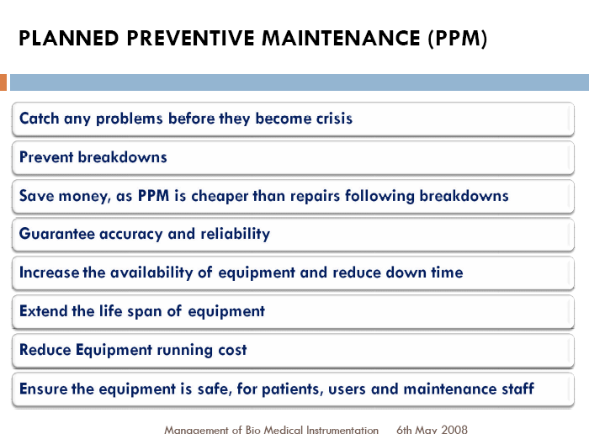

Slide 25


Slide 35
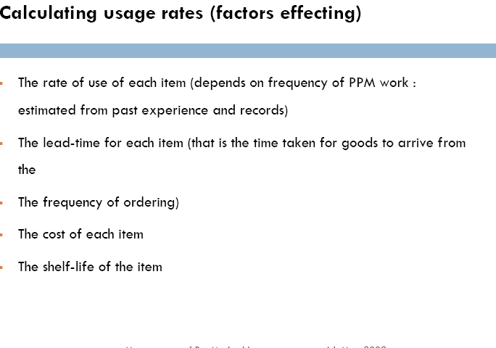

Slide 37


Slide 38
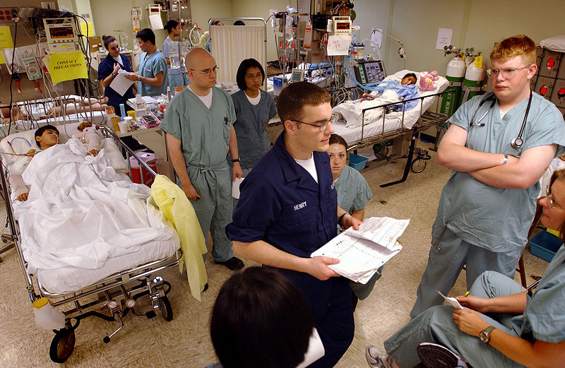
HOPE

Slide 39
But may never

Slide 40

THANKS TO ALL

