Slide 1
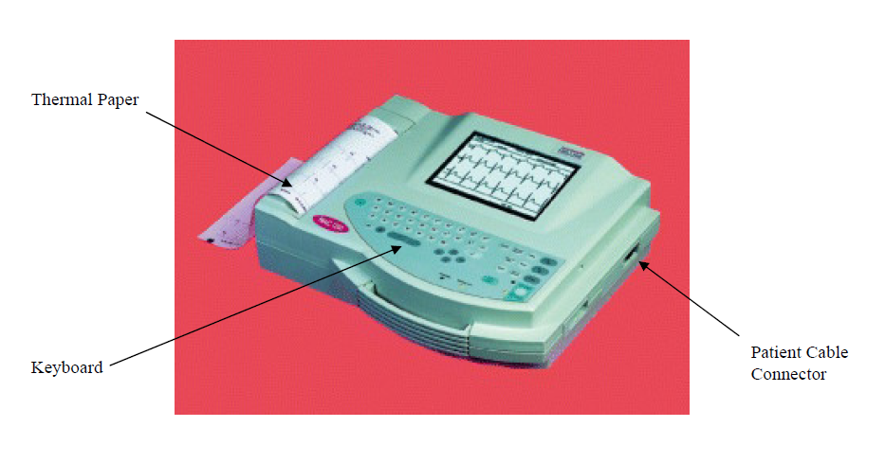
MAITENACE MANGEMENT OF AN ECG MACHINE

Slide 2
Welcome to My Presentation/Session
Dear participants
Salam / Adap/Nomosker / Peace

Slide 3
A 12-lead electrocardiogram
Presented
Engr. Md. Anwar Hossain
MS in BME, PhD In BME ( Research Part)
Unit Manager BME
NEMEMW & TC
MoH & FW
Dhaka, Bangladesh
Hotline: +8801711630313
Email ID: anwar.bme@gmail.com

Slide 4
Topics Outlines
Introduction
Anatomy of Heart
What is an ECG machine
Block diagram of an ECG machine
Trouble shooting and its preventive maintenance
Respiratory anatomy
Pulse oximetry and its working principle
Maintenance
Q & A
Thanks

Slide 5
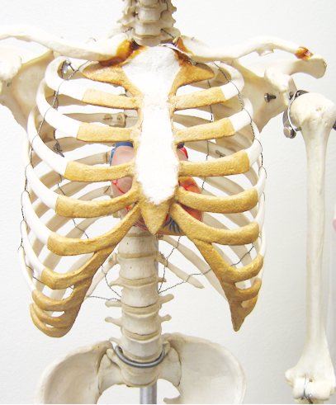
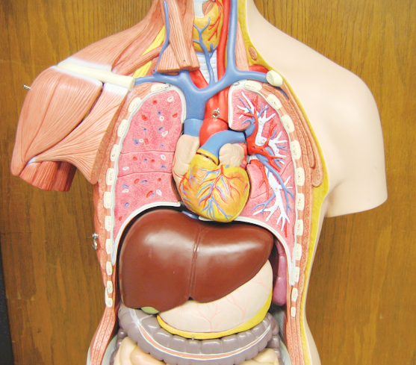
First, to make sure we know where the heart is …

Slide 6
Frontal view of heart
aVR
aVL
I
Limb Leads
III
II
aVF

Slide 7
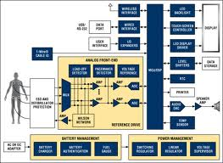

Slide 8
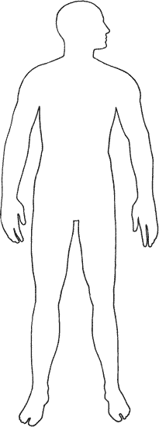
Sensing the heart’s electrical activity via electrodes (contacts placed on the surface of the body)

Slide 9
Sensing the heart’s electrical activity via electrodes (contacts placed on the surface of the body)
Note: anatomical orientation is from the subject’s perspective:

Slide 10
Lead I (toward left)
right arm
left arm
electrical polarity:
neutral or ground
negative
positive
right leg
left leg

Slide 11
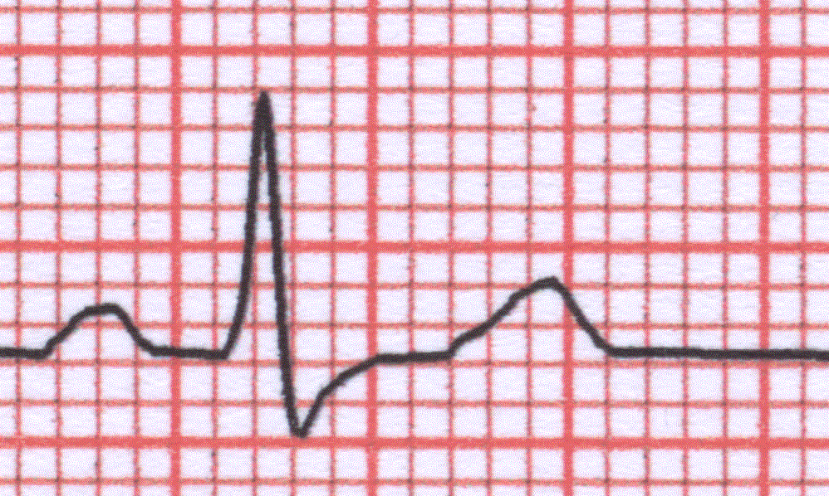
R
T
P
Q
S
The main, typical waves of an EKG.
(This particular tracing does not show a Q wave, a downward wave just before the R wave.)

Slide 12
Standard calibration of EKG recordings
1 cm = 1 mV
1 mm = 0.1 mV
1 mm = 0.04 seconds
25 mm/second
5 mm = 0.20 seconds

Slide 13
What is an ECG Machine?
ECG is a graphic record of electric currents that are generated by the heart muscles.

Slide 14
Electrical impulses are picked up by the surface electrode which are placed at various points on the body and connect the ECG machine to the body.

Slide 15
Objectives
To diagnose the presence of MI.
To diagnose the presence of cardiac dysrrhythmias.
To diagnose the presence of cardiac enlargement and size of cardiac champers.
To detect the electrolyte abnormalities especially K and Ca.

Slide 16
The 12-lead ECG provides “views” of cardiac electrical activity from 12 different vantage points on the body surface.

Slide 17
Function
ECG machines are used to monitor the electrical activity of the heart and display it on a small screen or record it on a piece of paper.
The recordings are used to diagnose the condition of the heart muscle and its nerve system.

Slide 18
How it works
The electrical activity is picked up by means of electrodes placed on the skin.
The signal is amplified, processed if necessary and then ECG tracings displayed and printed.
Some ECG machines also provide preliminary interpretation of ECG recording

Slide 19
There are 12 different types of recording displayed depending upon the points from where the recordings are taken.
Care must be taken to make the electrode sites clean of dirt before applying electrode jelly. Most problems occur with the patient cables or electrodes.

Slide 20
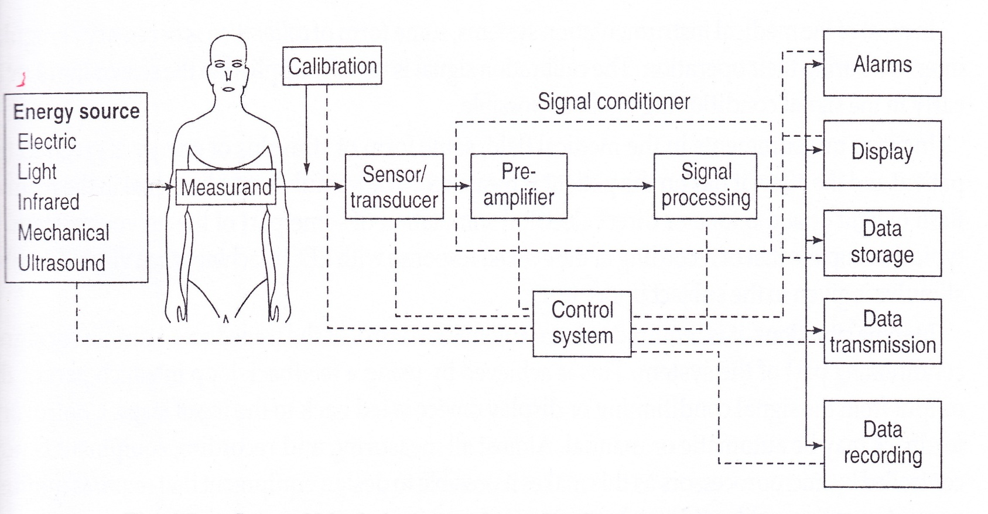
General Block Diagram of Medical Instrumentation System
General Diagram of Medical Instrumentation System

Slide 21
Examples of Biomedical signals
ECG: Electro cardio graph (Signal from heart of human body)

Slide 22
O! my soul you must have departure from the color world but what preparation have you taken for the departure ? Please try to the best think.

Slide 23
S/L | Fault | Possible Cause | Solution
1 | ECG traces have artifacts or base line drift | Improper grounding | Try with battery power only. If the recording improves then problem is with grounding. Check the grounding Power the machine from another outlet with proper electrical ground
2 | ECG traces have artefacts in one or more ECG traces , but not in all traces | Improper electrode connection with patient or problem with the ECG cable | Check the patient cable continuity with continuity tester. Replace cable if found faulty Check the electrodes expiration date Check patient skin preparation Check limb electrodes and chest electrodes for damage, replace if necessary

Slide 24
3 | Paper feed not advancing | Incorrect paper loading | Use instructions to reload paper
4 | Printing not clear or not | Printing head problem | Adjust the printing head temperature or position Clean the printing head with head cleaner. If no improvement, replace the printing head. Check the paper roller and replace if not smooth
5 | The machine shuts down after a few minutes while on battery power. | Problem with battery or charging circuit | Recharge the unit overnight If there is no improvement then replace the battery If still no improvement, refer to technician

Slide 25
Cleaning | Clean off dust with dry cloth and replace dust cover
Visual Checks | Check that battery charge indicator, power indicator and patient cable connector indicators are working
Function checks | Check the calibration of machine before use using 1mV pulse Check the baseline of the ECG recording is steady Check the printing is clear

Slide 26
Pulse Dosimeter

Slide 27
RESPIRATORY GAS PHYSIOLOGY

Slide 28
Respiratory Gasses
Normal Atmospheric Gasses:
Oxygen (O₂)
Carbon Dioxide (CO₂)
Nitrogen (N₂)
Water Vapor (H₂O)
Trace gasses:
Argon (Ar)
Neon (Ne)
Helium (He)

Slide 29
Respiratory Gasses
Most important respiratory gasses:
Oxygen (O₂)
Carbon Dioxide (CO₂)

Slide 30
Atmospheric Gasses
GAS† | PRESSURE (mm Hg) | PERCENTAGE (%)
Nitrogen (N₂) | 593.408 | 78.08
Oxygen (O₂) | 159.220 | 20.95
Argon (Ar) | 7.144 | 0.94
Carbon Dioxide (CO₂) | 0.288 | 0.03
Neon (Ne) | 0.013 | 0.0018
Helium (He) | 0.003 | 0.0005
TOTAL | 760 | 100
† = dry air at sea level.

Slide 31
Respiratory Gasses
GAS | Atmospheric Air (mm Hg) | % | Humidified Air (mm Hg) | % | Alveolar Air (mm Hg) | % | Expired Air (mm Hg) | %
N₂ | 597.0 | 78.6 | 563.4 | 74.0 | 569.0 | 74.9 | 566.0 | 74.5
O₂ | 159.0 | 20.8 | 149.3 | 19.7 | 104.0 | 13.6 | 120.0 | 15.7
CO₂ | 0.3 | 0.04 | 0.3 | 0.04 | 40.0 | 5.3 | 27.0 | 3.6
H₂O | 3.7 | 0.50 | 47.0 | 6.20 | 47.0 | 6.2 | 47.0 | 6.2
TOTAL | 760 | 100 | 760 | 100 | 760 | 100 | 760 | 100

Slide 32
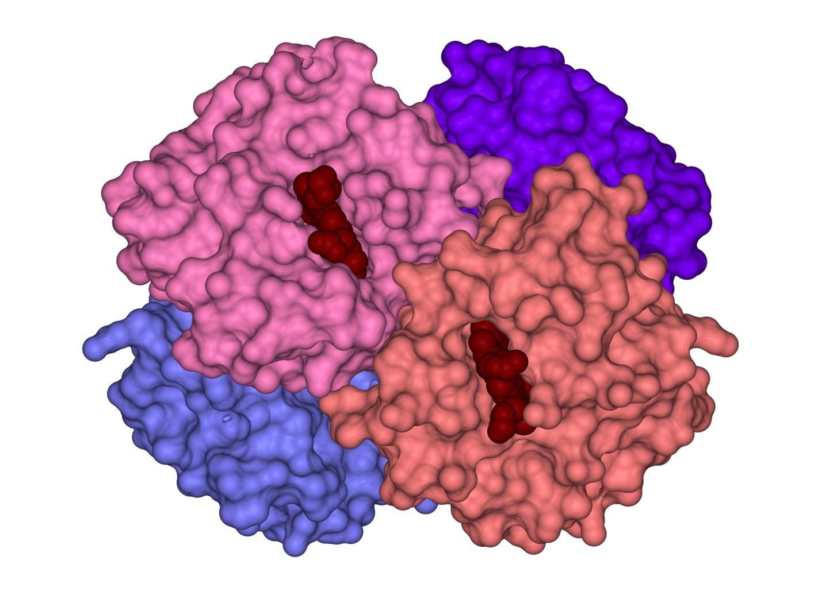
Hemoglobin Binding Sites

Slide 33
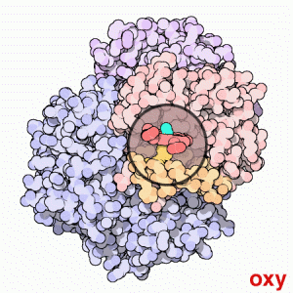
Hemoglobin
The binding of oxygen changes the conformation (shape) of the hemoglobin molecule.
Deoxyhemoglobin is converted to oxyhemoglobin.

Slide 34
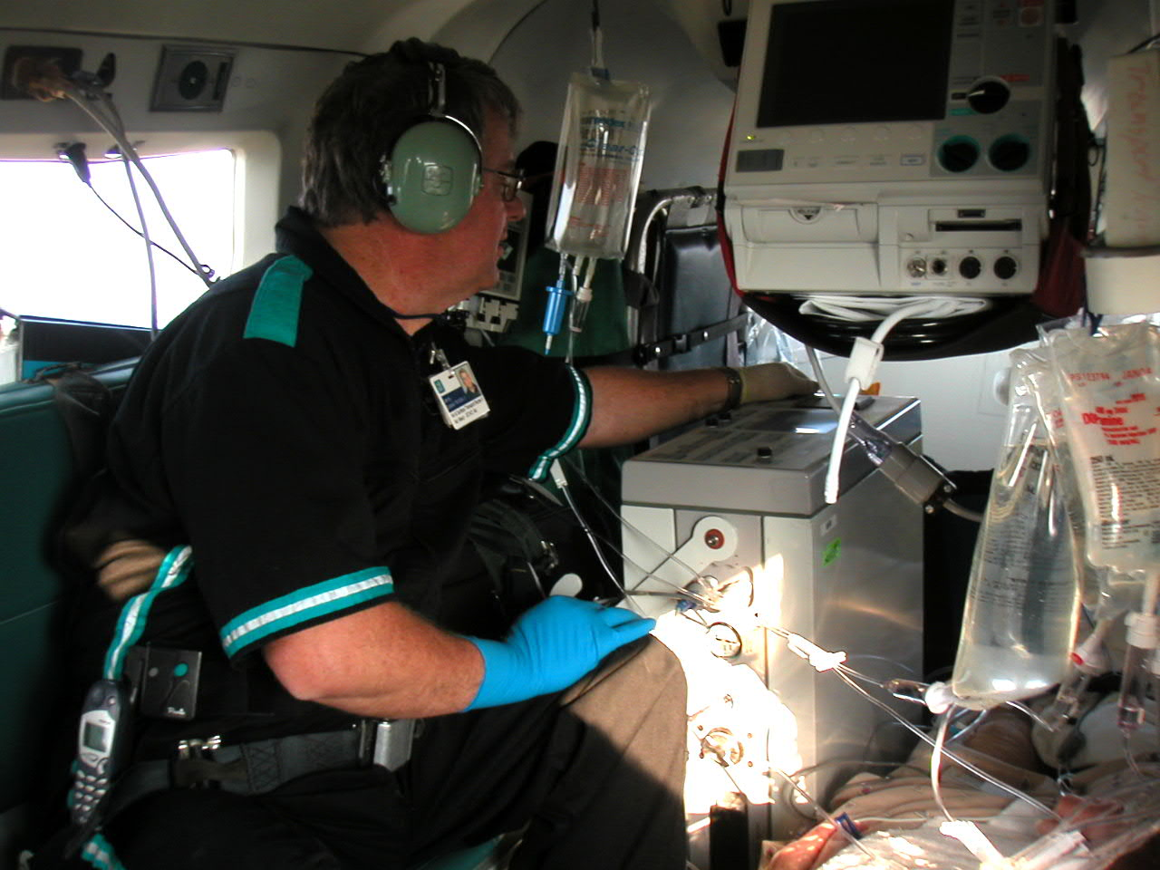
Respiratory Gas Measurement
Arterial Blood Gas Sampling
Pulse Oximetry
CO-Oximetry

Slide 35
Arterial Blood Gasses
Excellent diagnostic tool.
Impractical in the prehospital setting.
Parameter | Normal
pH | 7.35-7.45
PO₂ | 80-100 mm Hg
PCO₂ | 35-45 mm Hg
HCO₃⁻ | 22-26 mmol/L
BE | -2 - +2
SaO₂ | > 95%

Slide 36
OXYGEN MONITORING

Slide 37
Pulse Oximetry
Introduced in early 1980s.
Non-invasive measurement of oxygen saturation.
Safe
Inexpensive

Slide 38
Pulse Oximetry
How it works:
Probe is placed over a vascular bed (finger, earlobe).
Light-emitting diodes (LEDs) emit light of two different wavelengths:
Red = 660 nm
Infrared = 940 nm

Slide 39
Pulse Oximetry
Some light is absorbed by:
Arterial blood
Venous blood
Tissues
Light that passes through the tissues is detected by a photodetector.
© Brook Wainwright

Slide 40
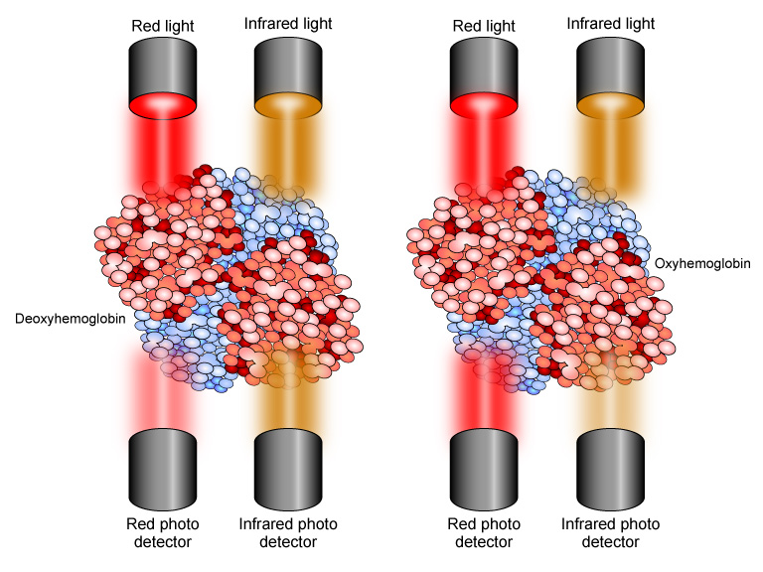

Slide 41
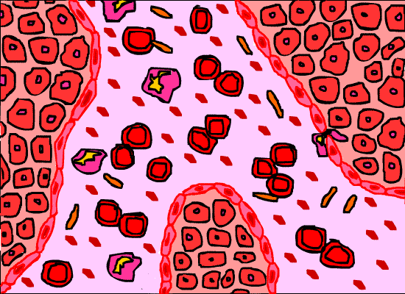
Pulse Oximetry
Only inflow of blood is used to determine SpO₂.
Hence the name “Pulse Oximetry”
Hb and HbO₂ absorb light and different rates due to color and conformation.

Slide 42
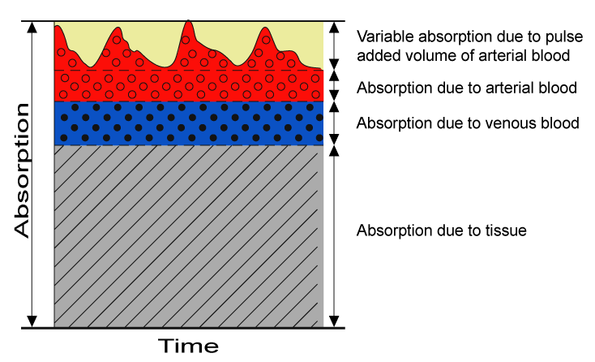
Pulsatile Flow
This is the band used to measure SpO₂.

Slide 43
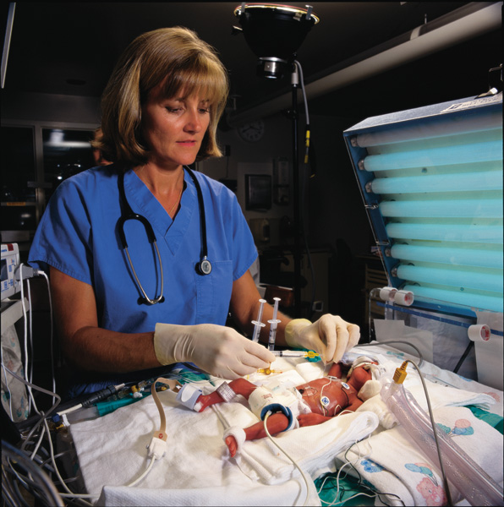
Oximetry Probe Placement
Finger
Earlobe
Heel (neonates)

Slide 44
Oximetry Probe Placement
Accuracy falls when LEDs and photoreceptors poorly aligned.
Accuracy decreases with lower pulse oximetry readings.

Slide 45
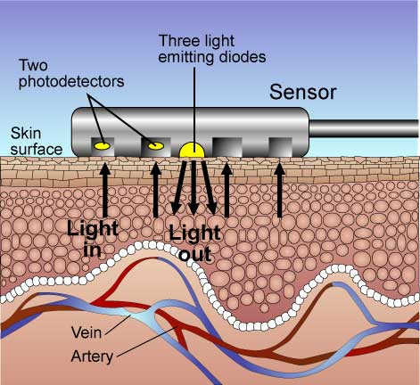
Pulse Oximetry
Some manufacturers use reflective oximetry for monitoring.
LEDs and photodetectors in same electrode.
Light reflected from the tissues and detected by photodetectors and findings interpreted by the software in the oximeter.
Can be used on forehead or back.

Slide 46
Pulse Oximetry
HbO₂ absorbs more infrared light than Hb.
Hb absorbs more red light than HbO₂.
Difference in absorption is measured.
Ratio of absorbance matched with SpO₂ levels stored in the microprocessor.

Slide 47
Perfusion Index
Reflects the pulse strength at the monitoring site.
Ranges from 0.02% (very weak pulse strength) to 20% (very strong pulse strength).
Helps determine best site to place probe.

Slide 48
Pulse Oximetry
SaO₂ or SpO₂?
SaO₂ used for oxygen saturation readings derived from arterial blood gas analysis.
SpO₂ used for oxygen saturation readings from pulse oximetry.
SpO₂ and SaO₂ are normally very close.

Slide 49
Pulse Oximetry
Pulse oximetry tells you:
SpO₂
Pulse rate
Pulse oximetry cannot tell you:
O₂ content of the blood
Amount of O₂ dissolved in blood
Respiratory rate or tidal volume (ventilation)
Cardiac output or blood pressure.

Slide 50
Who Should Use?
Any level of prehospital care provider who administers O₂.
First Responders
EMTs
EMT-Intermediates
Paramedics

Slide 51
Second-Generation Technology
Newer technology uses signal processing to minimize artifacts and false readings:
Adaptive Filters
Signal Processing Algorithms
Improved Sensors

Slide 52
Second-Generation Technology
Technology prevents:
Motion artifact.
False readings during low-flow states.
False bradycardias.
False hypoxemias.
Missed desaturations.
Missed bradycardias.
Data dropouts.
Effects of dyshemoglobins.

Slide 53
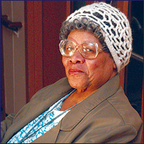
Myths
Age affects SpO₂
Gender affects SpO₂
Anemia affects SpO₂
SpO₂ inaccurate in dark-skinned individuals.
Jaundice affects SpO₂.

Slide 54
Always treat the patient and not the oximeter.

Slide 55
Reading the Oximeter
SpO₂ (%)
PI (%)
Signal Strength
Pulse Rate (bpm)

Slide 56
What Does it Mean?
SpO₂ READING (%) | INTERPRETATION
95 – 100 | Normal
91 – 94 | Mild Hypoxemia
86 – 90 | Moderate Hypoxemia
< 85 | Severe Hypoxemia

Slide 57
Interventions
SpO₂ READING (%) | INTERPRETATION | INTERVENTION
95 – 100 | Normal | Change FiO₂ to maintain saturation.
91 – 94 | Mild Hypoxemia | Increase FiO₂ to increase saturation.
86 – 90 | Moderate Hypoxemia | Increase FiO₂ to increase saturation. Assess and increase ventilation.
< 85 | Severe Hypoxemia | Increase FiO₂ to increase saturation. Increase ventilation.

Slide 58
Oximetry to Assess Circulation
Oximeter probe can be placed onto tissue distal to an injury to detect circulation.
Oximeter can monitor distal circulation with fractures and crush injuries.
Clinical correlation always needed.

Slide 59
Oximetry to Assess Circulation
Oximeter probe can be placed onto tissue distal to an injury to detect circulation.
Oximeter can monitor distal circulation with fractures and crush injuries.
Clinical correlation always needed.

Slide 60
APPLICATION OF PULSE OXIMETRY

Slide 61
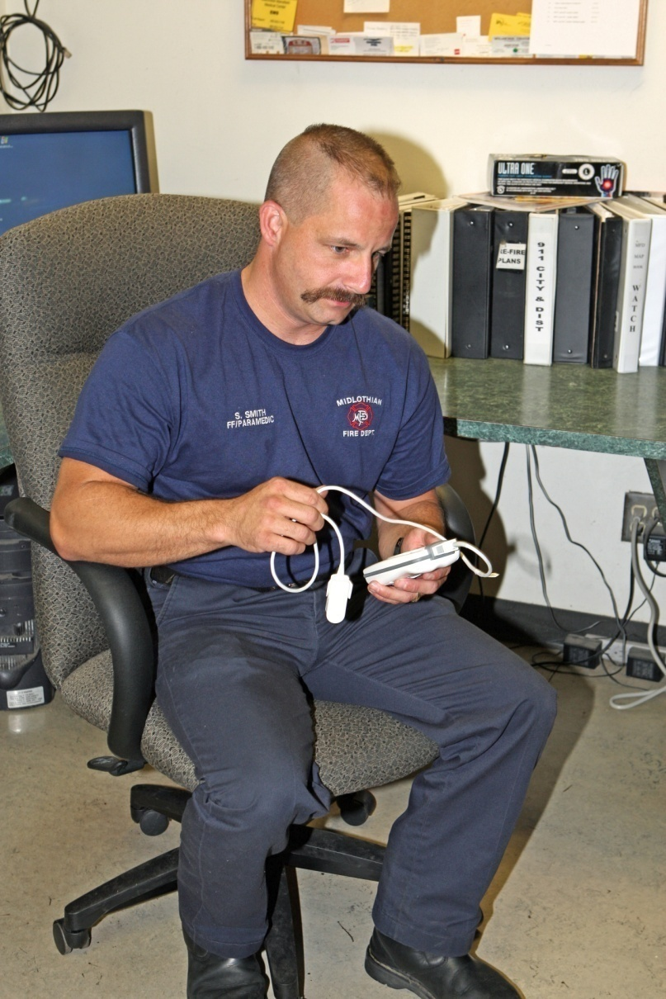
Pulse Oximetry
Prepare the device:
Fresh batteries
Wires and probe in good repair.

Slide 62
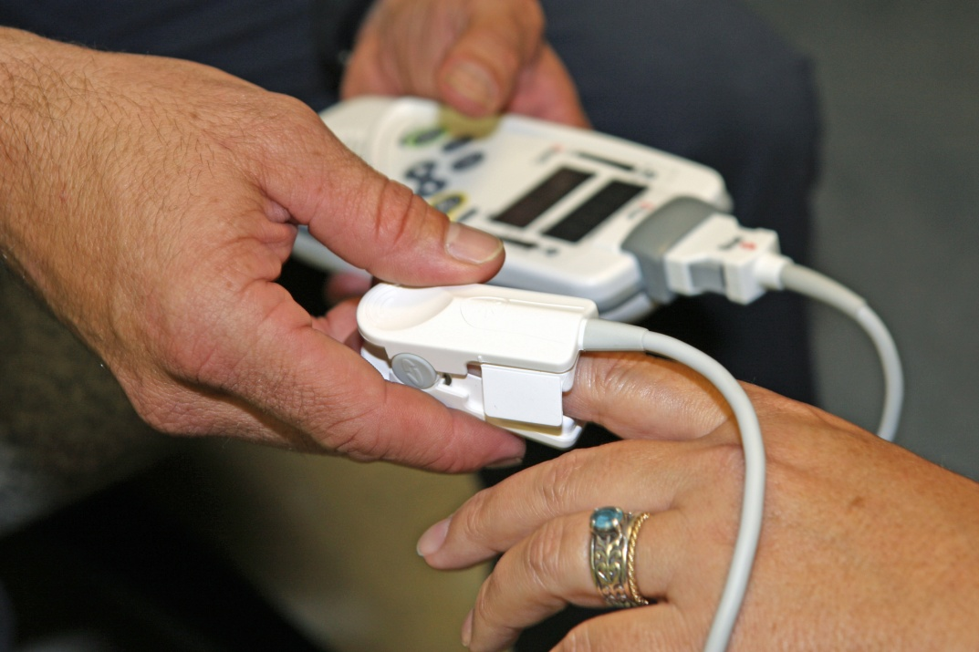
Pulse Oximetry
Explain the procedure to the patient.
Apply pulse oximetry probe according to manufacturer’s recommendations.

Slide 63
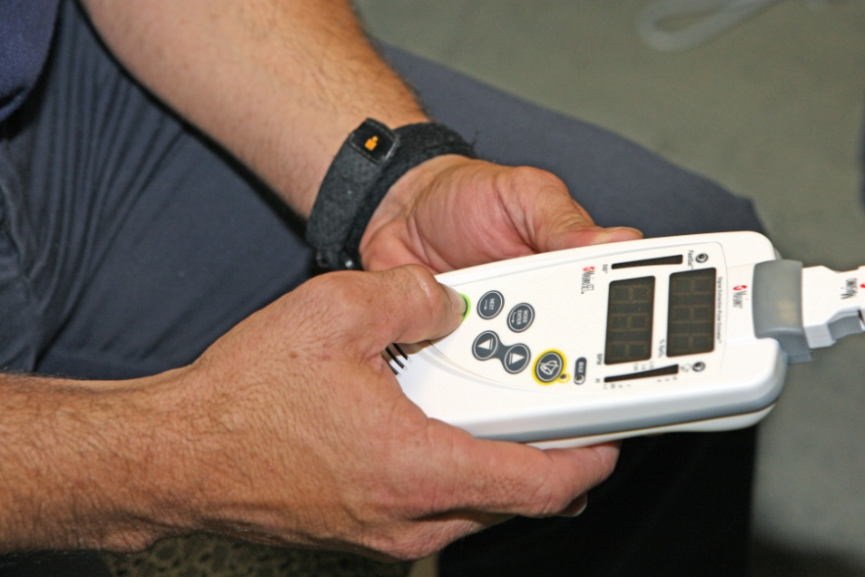
Pulse Oximetry
Turn on the oximeter.
Allow it to proceed through start and self-checks.

Slide 64
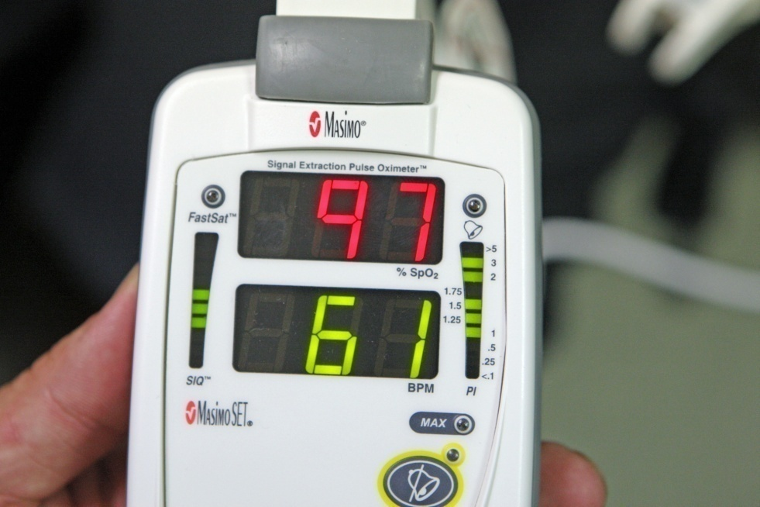
Pulse Oximetry
Check for readings.
Check Perfusion Index (PI).
Adjust probe, if needed, for best signal.

Slide 65
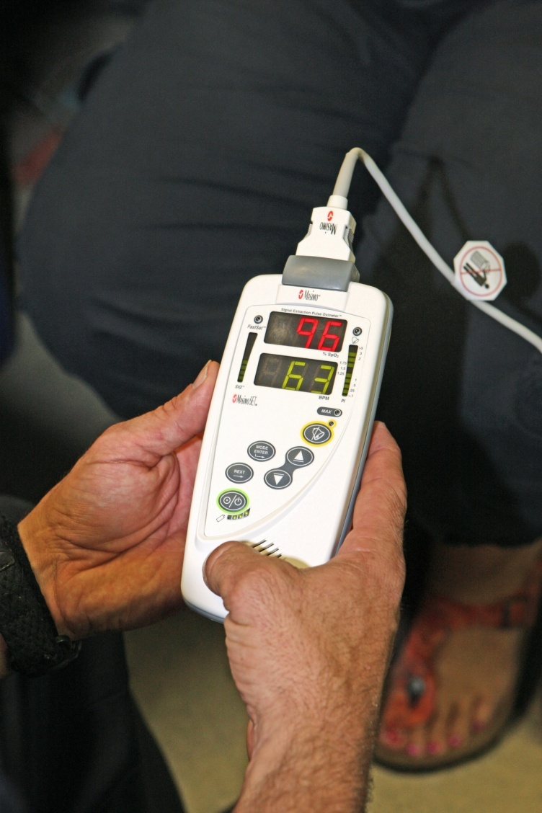
Pulse Oximetry
Monitor pulse rate and SpO₂.
Adjust oxygen administration to maintain desired SpO₂ levels.

Slide 66
OXYGEN ADMINISTRATION

Slide 67
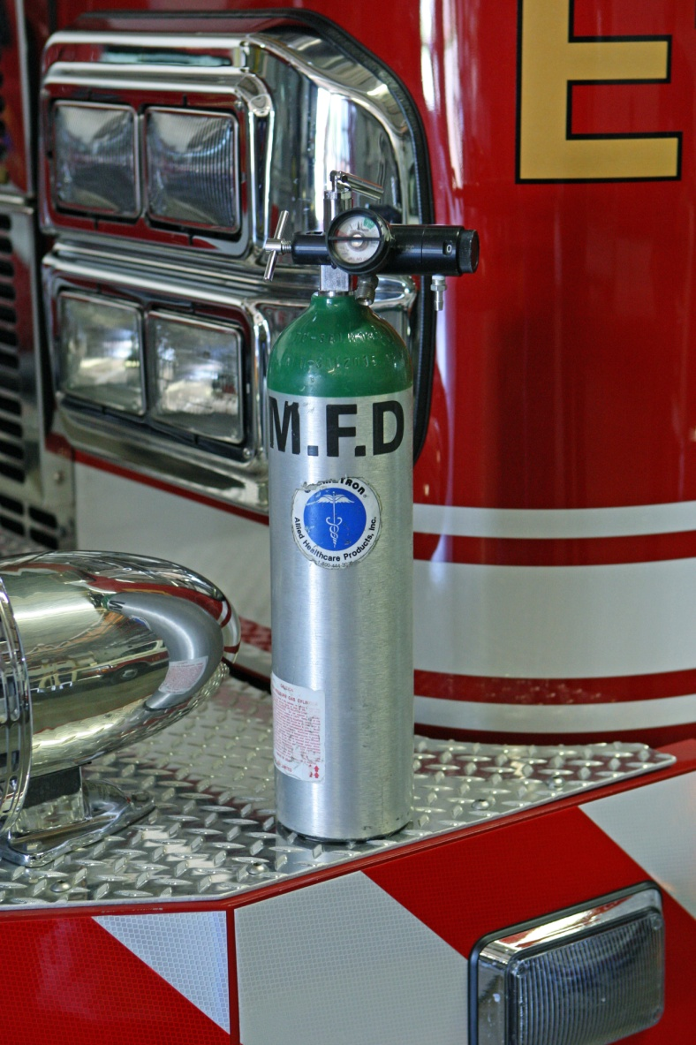
Oxygen Administration
Items required:
Oxygen source
Pressure regulator
Flow meter
Humidifier (optional)
Connecting tubing
Delivery device

Slide 68
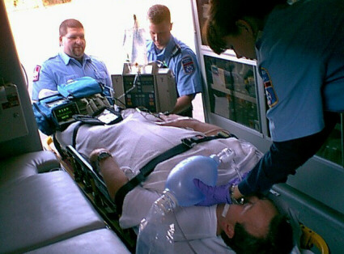
Oxygen Administration
Delivery devices:
Oxygen need and patient comfort should drive device selection.

Slide 69
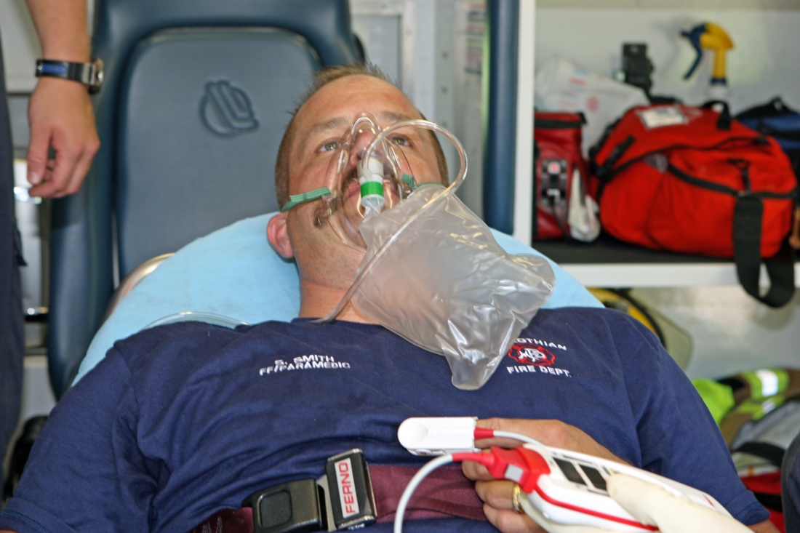
Oxygen Administration
A non-rebreather mask delivers close to 100% oxygen.

Slide 70
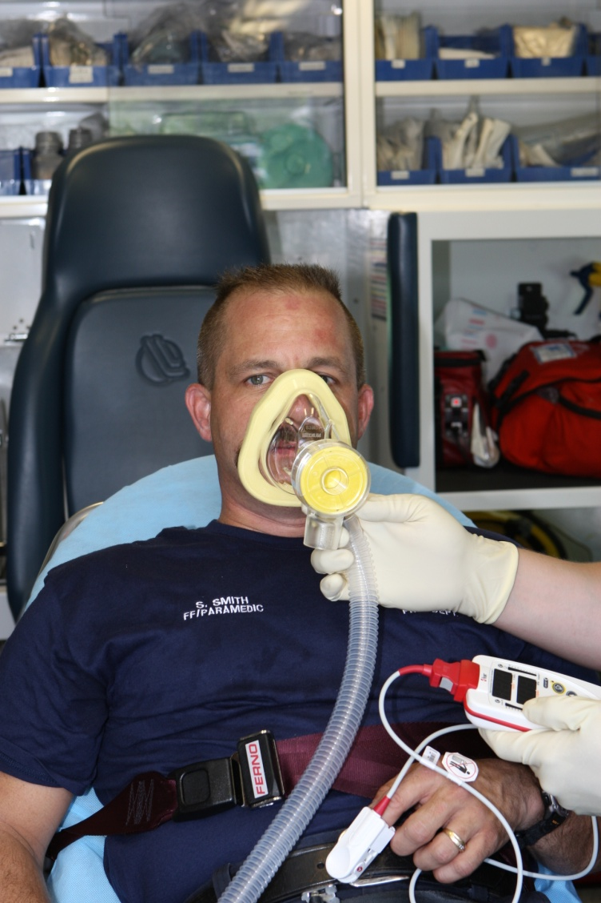
Oxygen Administration
Continuous positive airway pressure (CPAP) is effective in maximizing hemoglobin oxygen saturation.
Uses include:
Congestive heart failure
Acute pulmonary edema
Drowning
CO exposure

Slide 71
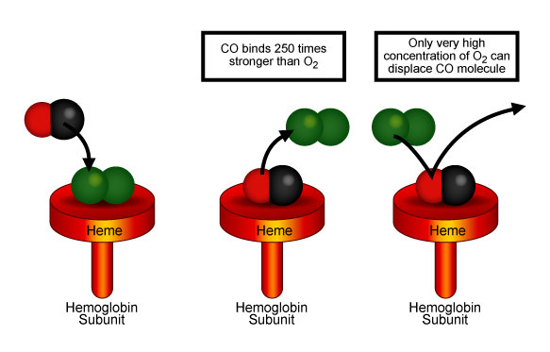
Carbon Monoxide
CO displaces O₂ from the hemoglobin molecule forming carboxyhemoglobin (COHb).
CO affinity for hemoglobin ~250 times greater than O₂.
CO-Hb has a bright red color.
Patients become progressively hypoxemic.

